Slide 1
Embedding the Sussex VCSE sector in the Sussex Health and Care system
Who we are and what we do

Slide 2
Our Ambition
To work collaboratively and strategically with health and care partners to create meaningful change in people’s lives. To reduce health inequalities and improve population health; through the creation of services and support that are sustainable, fit for purpose, timely and proactive. (2022)
Enabling connectivity and conversations between Sussex health and care partners and the voluntary, community and social enterprise sector (VCSE)

Slide 3
What is the Sussex VCSE Leaders ALLIANCE?
We are an informal collective of experienced VCSE leaders from across Sussex, who give time and expertise to work together to connect health and care partners with local voluntary, community and social enterprise leaders in Sussex to inform and co design strategic planning, development and delivery of services to achieve improved health outcomes for our communities.
We are doing this in a number of ways, which include:
A developing strategic VCSE representation programme, working within NHS Sussex and the integrated care system to inform planning and development work, bringing local knowledge and expertise into policy development, decision making and the delivery of health and care services across Sussex.
Leading the development of a Sussex VCSE Commissioning Framework between health and care partners and the VCSE that will provide a shared understanding of the commissioning cycle and the processes involved.
Planning the development of a memorandum of understanding (MOU) between the VCSE and health and care partners. By establishing shared principles and collaborative actions, we hope that the MOU will help foster close, effective working relationships, facilitating joint efforts to address health inequalities and improve outcomes for the people of Sussex.
Creating a dedicated health and care intranet for the voluntary, community and social enterprise sector in Sussex; a source of information about the sectors involvement in the integrated care system.
he health system.

Slide 4
The alliance within the wider sector
Sussex VCSE Networks
Sussex VCSE Leaders Alliance
Sussex Health and
Care
Assembly
Sussex VCSE
Community organisations and groups
4473 general registered charities
6,236 voluntary organisations (not registered)
21,000 estimated employees
VCSE networks across Sussex and at Place, Neighbourhood, District and Borough, Community, PCNs and LCNs providing wider and local VCSE with insight and reach to communities and specialist expertise
Strategically aligning/embedding VCSE within ICS. Supports development of ICS objectives through collaboration /networking, funded projects, information sharing and learning. Aligned at Exec level to ICB Chair, CEO and officers.
3 VCSE representatives – 1 per Place

Slide 5
the Sussex VCSE health and care intranet

Slide 6
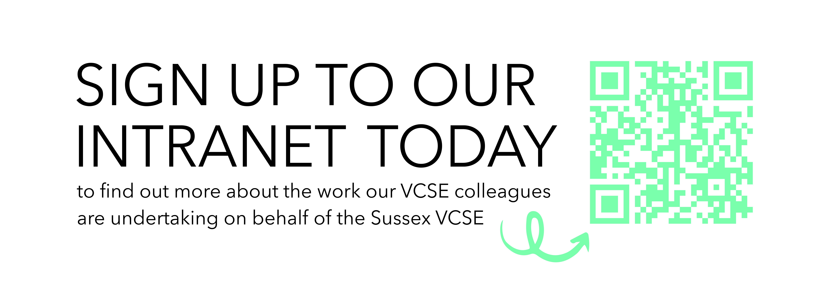
WHY Should I sign up to the intranet?
Our intranet pages are a source of many resources. You’ll find:
Information about the work of the Sussex VCSE Leaders Alliance.
Who your VCSE representatives are and what areas they are working in, on your behalf.
Crucial updates and latest health and care news and opportunities about funding, training and learning and development opportunities.
Other individuals from across the VCSE and NHS Sussex to increase your connectivity, just register your profile on the Who's Who.
Up to date information about the developments within the Sussex Health and Care integrated care system.
Handy resources.

Slide 7
The Team
Jayne Ross: Strategic Lead
Amardeep Rai: Project Manager
Kate Durrant: Communications Officer

